Slide 1
MPC for Robotic Arm Path Planning and Control
ECH 267 Final Project
Jonathan Dorsey

Slide 2
Introduction

Slide 3
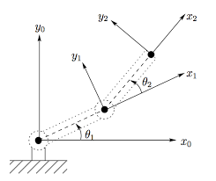
2 Link – Planar Robot Manipulator

Slide 4
Robot Dynamics

Slide 5
Control & Path Planning via MPC
Control
Path Planning

Slide 6
Model Predictive Control of Planar Robot
MPC is the desirable choice for MIMO system control
Natively handles constraints.
Depending on the dynamics & constraints be quite fast (> 10-20Hz)
Robots are often fully sensored and do not require rea-time state estimation.

Slide 7
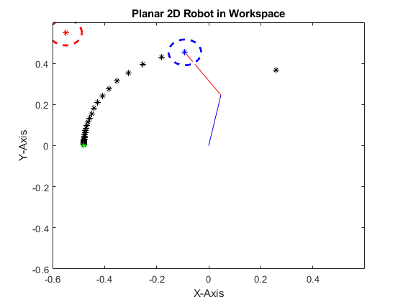
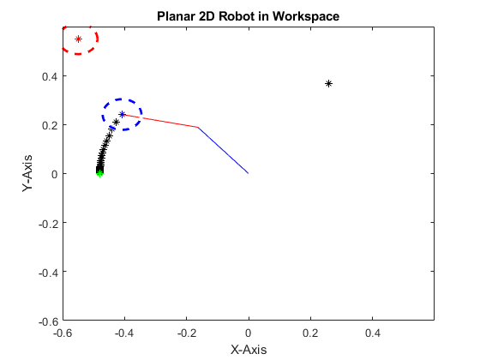
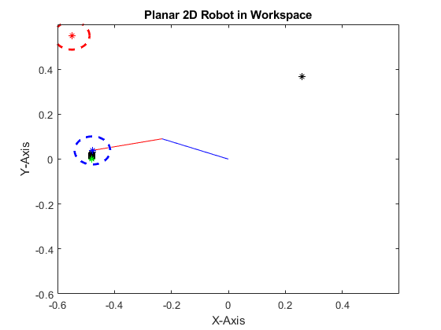
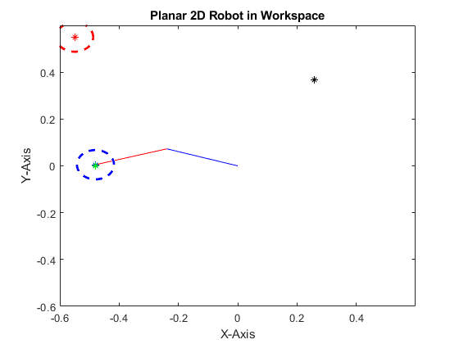





Slide 8
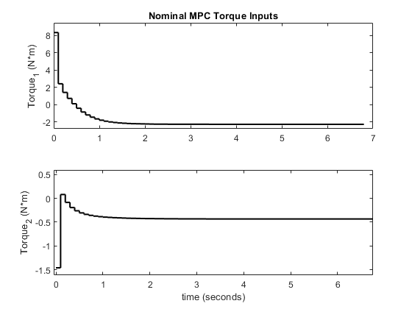
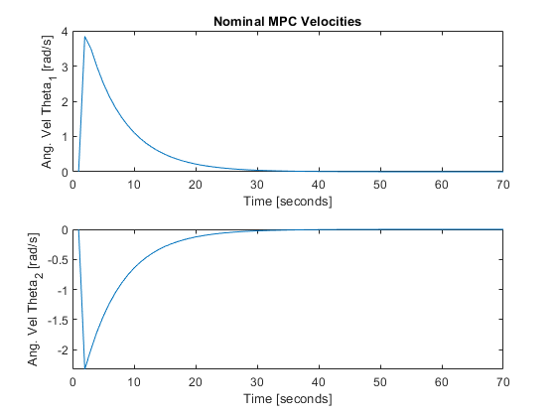
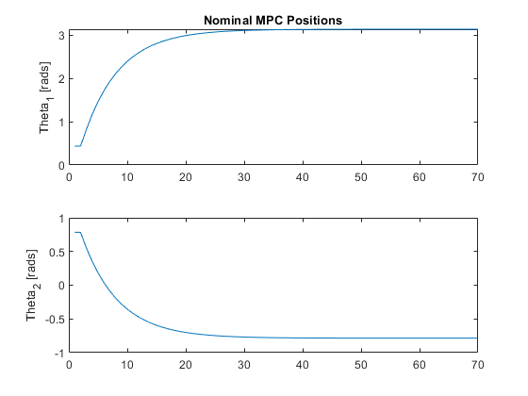
Pose to Pose Control via MPC

Slide 9
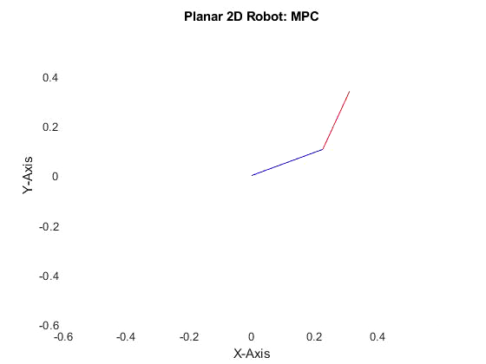

Slide 10
MPC with Plant/Model Mismatch

Slide 11
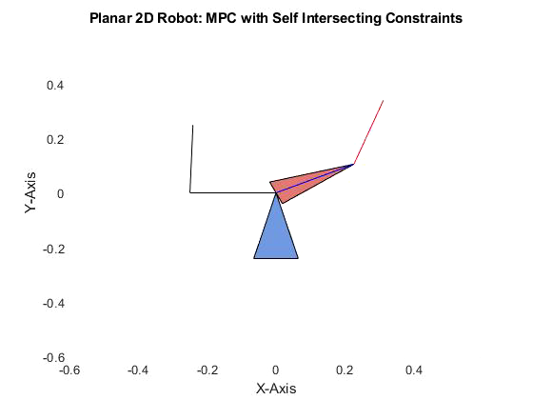
Limited Motion Constraints
Feasible Goal Pose
Robots can often have physical limitations on range of possible motions.
This can be implemented by adjusting the bounds of the inequality constraints for the angular position states of the robot.

Slide 12

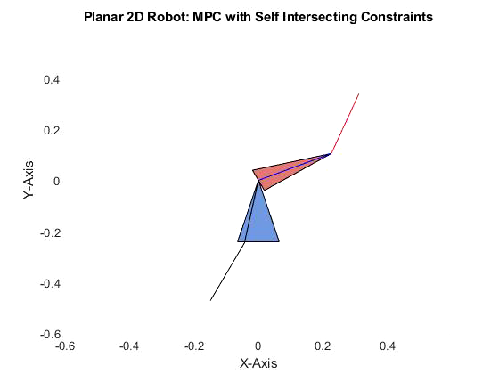
Infeasible Goal Pose

Slide 13
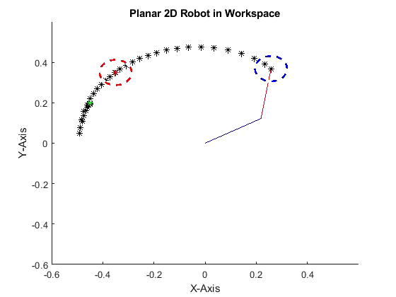
MPC - Obstacle Avoidance

Slide 14
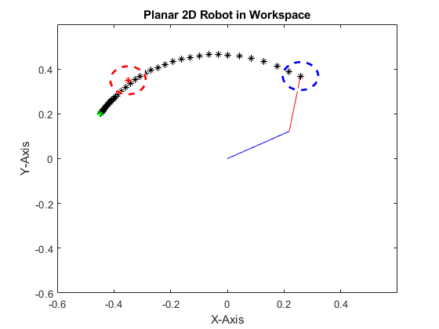
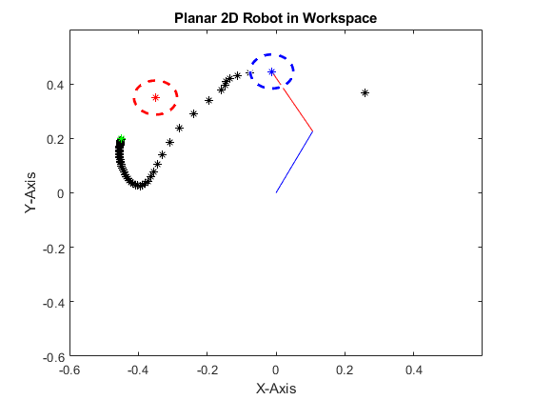
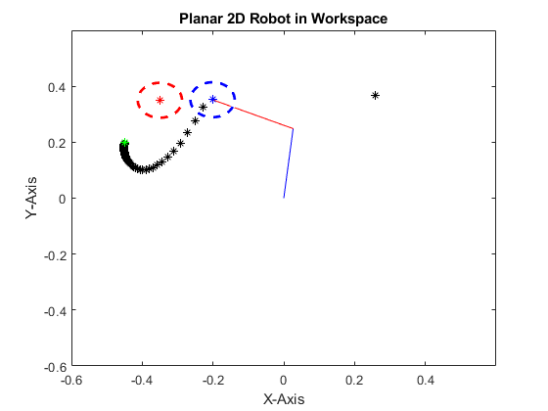
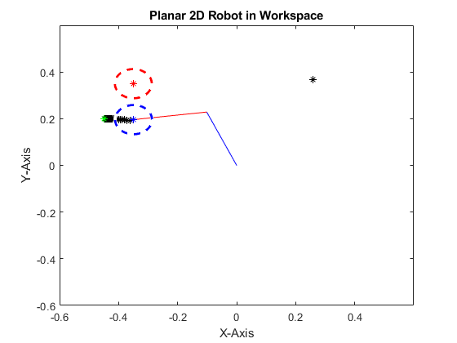
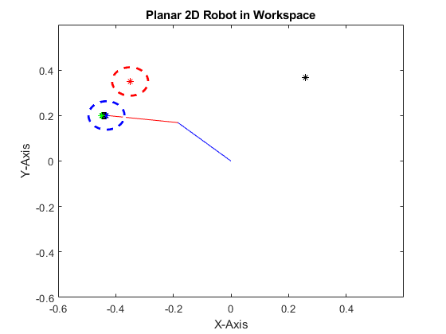

Slide 15
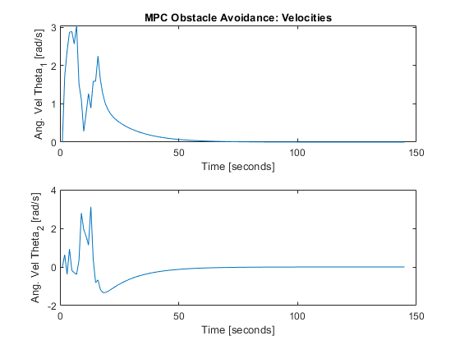
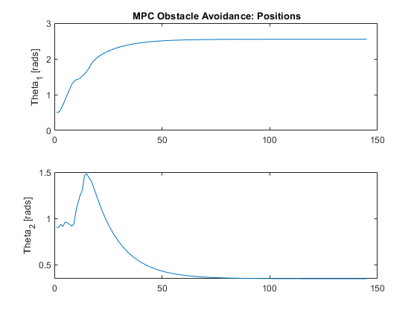
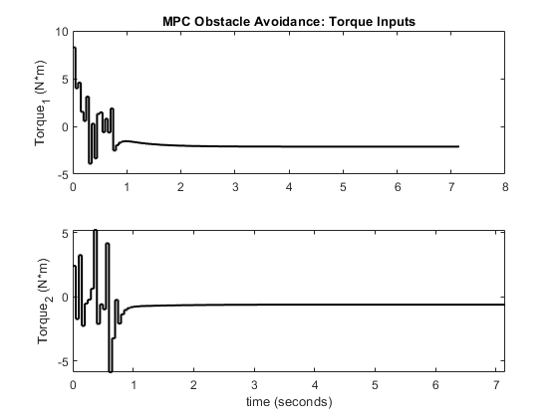

Slide 16
MPC as Supervisory Controller

Slide 17
Linearized System

Slide 18
Linearized System

Slide 19
MPC for Path Planning
It is often desirable to know the path the system will take, and/or control mechanisms and parameters which generate this path (shortest, minimal energy, distance from obstacle…etc.)
MPC can be used as means of path planning by leveraging the prediction horizon at each iteration as a feasible path from a starting pose to and goal pose.
Multiple Shooting returns both optimal state & actions over prediction horizon according to model.
These states in the prediction horizon can be used to define a smooth path between two points in space, which other controllers or system can sample at any arbitrary resolution.
MPC for planning has the benefit of robustness to uncertainty which MPC for control greatly benefits

Slide 20
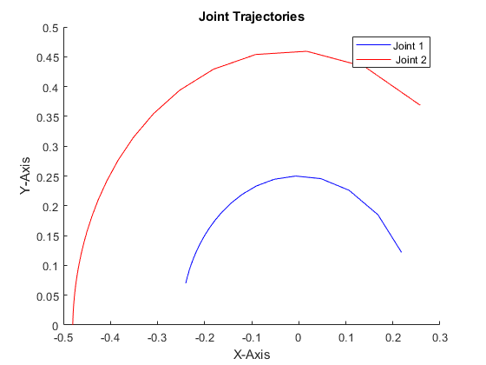
Joint Position Trajectories

Slide 22
Path Planning with Obstacle Avoidance
It is desirable to avoid obstacles which occupy the most direct path from one pose to another.
Define minimum distance from object inequality constraint.
Heavily penalize violations of minimum distance from object

Slide 23
Problems with MPC Path Planning
While robust (due to feedback) the solutions times can vary drastically (<50ms per step -> 10 seconds per step) even when only considering stationary objects.
MPC formulation can affect the performance
Added Inequality constraints
Slack Variables
Heavy penalty in loss function

